Slide 1
TIME-DOMAIN AUDIO SOURCE SEPARATION
Course Project EE698R
Original Paper by : Yi Luo, Nima Mesgarani
[link to paper]
[Drive link containing ipynb and models]
Team name - random.rand()
Munish Gupta(190519), Dharoor Sai Ashwith(190284)
https://arxiv.org/pdf/1711.00541v1.pdf

Slide 2
TASNet
TIME-DOMAIN AUDIO SEPARATION NETWORK
Why in Time-domain?
Problem with Phase modelling
Window size - Latency
Leakage of values in frequency bins

Slide 3

Task
- In this paper, ‘Cocktail Party problem’ – Single channel Speech source separation is tackled.
- It can also be used to do Music source separation.
Dataset
For Speech source separation, Librispeech.
- It has annotated speech audio files of single speakers.
- Added 2 randomly picked files to make mixed signal.
Pre-processing

Slide 4


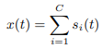
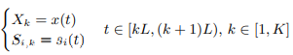
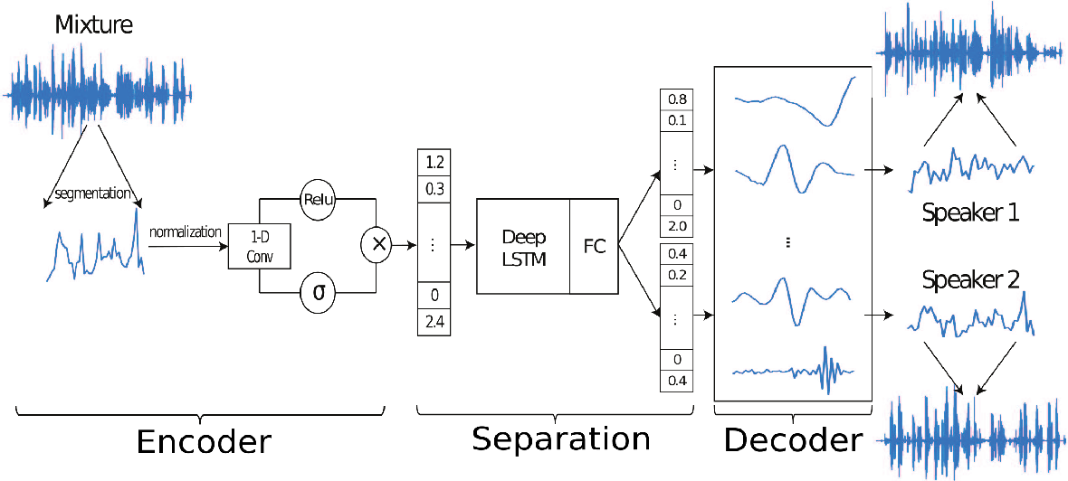


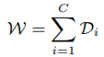
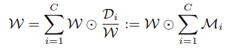

Network Architecture

Slide 5
The Network Architecture is based on structure of a computational algorithm that was successful in separating sources for Cocktail Party problem – ICA
Since we haven’t derived any features from our audio, like spectrogram, for temporal analysis, first we pass our data through a encoder, which performs 1-D convolution of frames of our mixture signal to transform audio signal into feature space of 500-D.
Output of this encoder is a 500-D weight vector for each frame of mixture signal.
Now these weight vectors are passed through a LSTM network, which learns temporal patterns in the signal in this feature space and outputs 2 Mask vectors- one for each source signal.
Now there is a decoder network that transforms these weight vectors back into frames of audio signal of separated sources. These are joined together to recover separated source signals.

Slide 6
Loss function
After decoding both the output vectors, since there is no characteristic distinction between both source signals as both are speech signals, we don’t know which estimated signal is to be compared with which source signal. So Here we use a method called Permutation Invariant Training.
We used Scale Invariant – Mean square loss as metric to optimise the network.

Slide 7
WHAT WE IMPLEMENTED V/S WHAT WAS GIVEN IN THE PAPER
In the paper, only architecture of separator was given(It’d be clearer to view picture given in Slide 4). The architecture of encoder and decoder was not mentioned. //along with other small suggestions such as skip layers were missing.
Problem of Diminishing gradient - We started with encoder and decoder structures each with 8 convolutional layers. In the course of training, we saw that the absolute values of gradient in encoder layers were getting very low and there was no decrease in loss as encoder was not being trained sufficiently. /////, i.e., the information from LSTM layers wasn’t getting carried to decoder and encoder.
Solution tried - First we tried by decreasing the number of layers in encoder and decoder. But since LSTM unrolls into large number of layers, we also later added skip connections between encoder and decoder layers as it helps in vanishing gradient problem and also in reconstruction.

Slide 8
Encoder - Decoder architecture : At first, we implemented eight layers of Conv1D net starting from each window of size 1 X 80, and transformed it into a vector of size 1 X 500, where each weight in this vector has whole window as its receptive field. Later, we changed same the network to 4-layer structure, where window size was decreased to 66 samples but output size is same.
Problem faced : While training the above model, we observed that reconstruction was very much noisy. The end result too wasn’t impressive as it was noisy and both the outputs essentially gave the same sound. The waveform of the outputs weren’t same(i.e. Same output wasn’t getting copied to both channels).
Later to improve the reconstruction by decoder, we added skip-connections between encoder and decoder, where we concatenated outputs of encoder to decoder before upampling.
Problem faced : After adding the skip connections, reconstruction became less noisy, but still the sources were not separated. Both the separated estimates had both the sources in them and they sounded similar, even though values were different.
We also tried with different loss functions - SI-SDR, SI-SNR and MSE.

